Slide 1



Python Tsunami
– April 7th-8th –

Slide 2
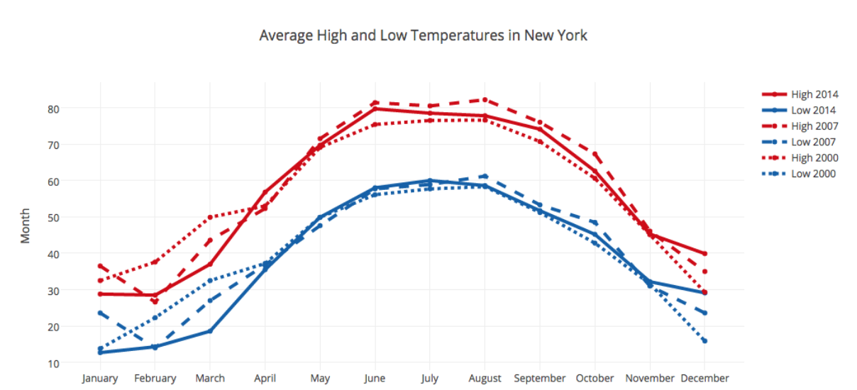
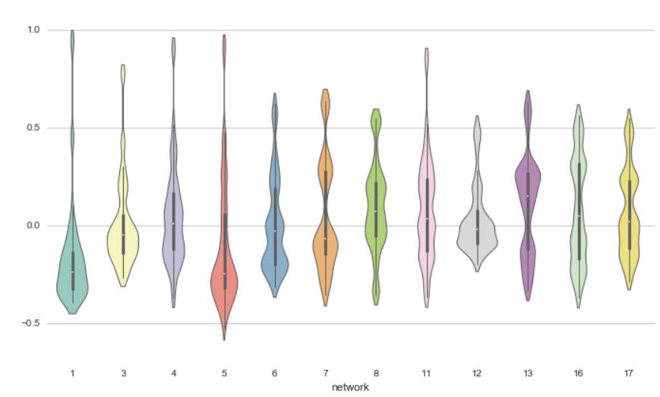
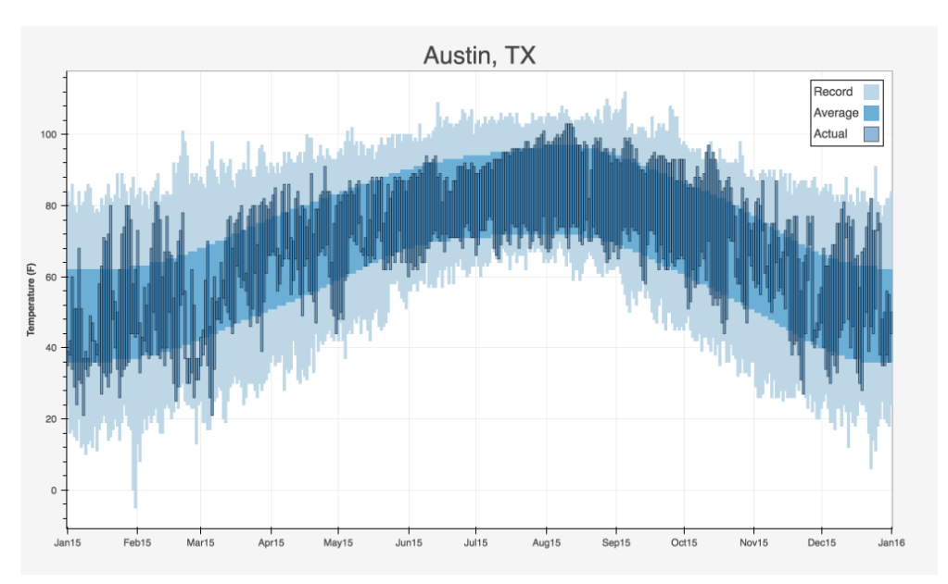
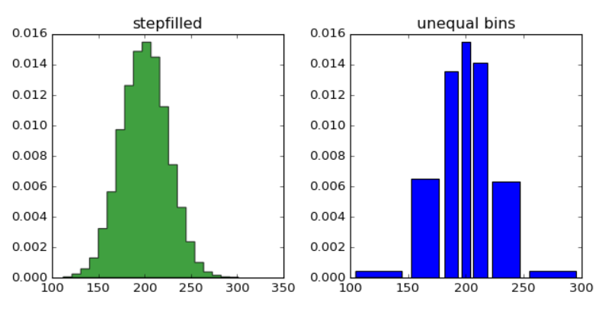
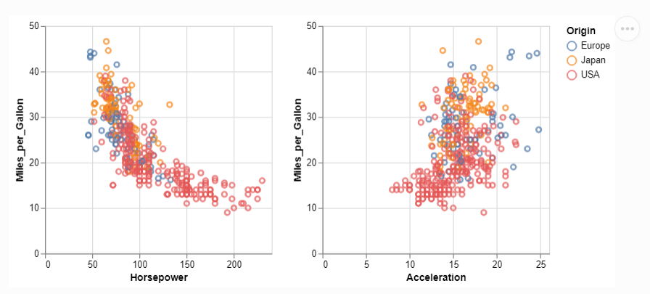
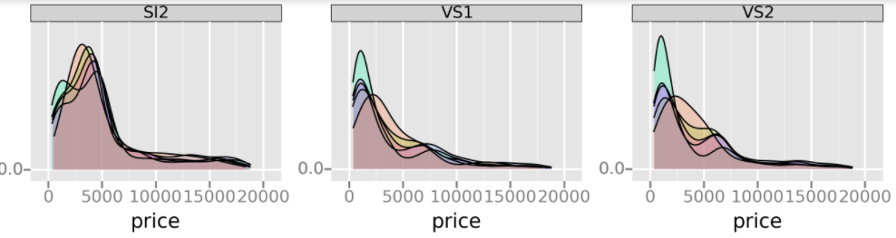
Visualizing Data with Python
Multiple Options (maybe too many)
Matplotlib (https://matplotlib.org/)
Seaborn (https://seaborn.pydata.org/)
plotnine (ggplot-like) (https://plotnine.readthedocs.io)
Bokeh (https://bokeh.org/)
Altair (https://altair-viz.github.io/)
Plotly (https://plotly.com/python/)

Slide 3
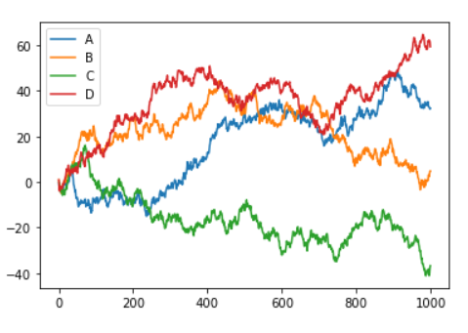
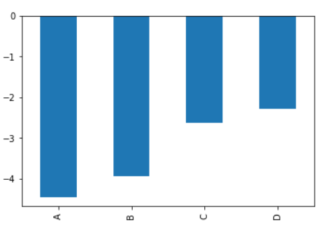
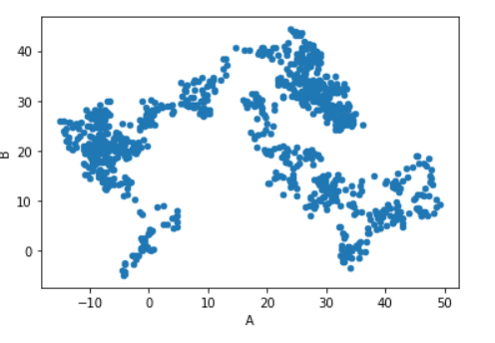
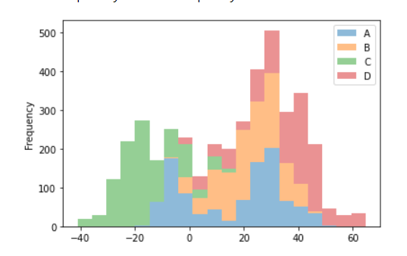
Also - Pandas
df.plot()
df.iloc[2].plot.bar()
https://pandas.pydata.org/pandas-docs/stable/user_guide/visualization.html
df.plot.scatter(x, y)
df.plot.hist(stacked=True, bins=20, alpha=0.5)

Slide 4
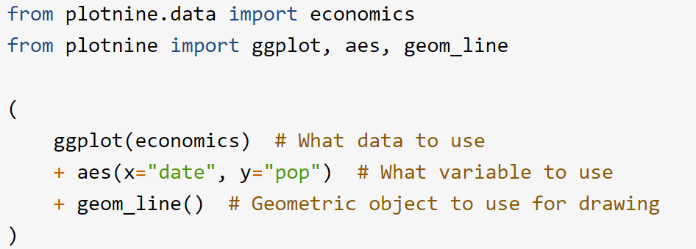
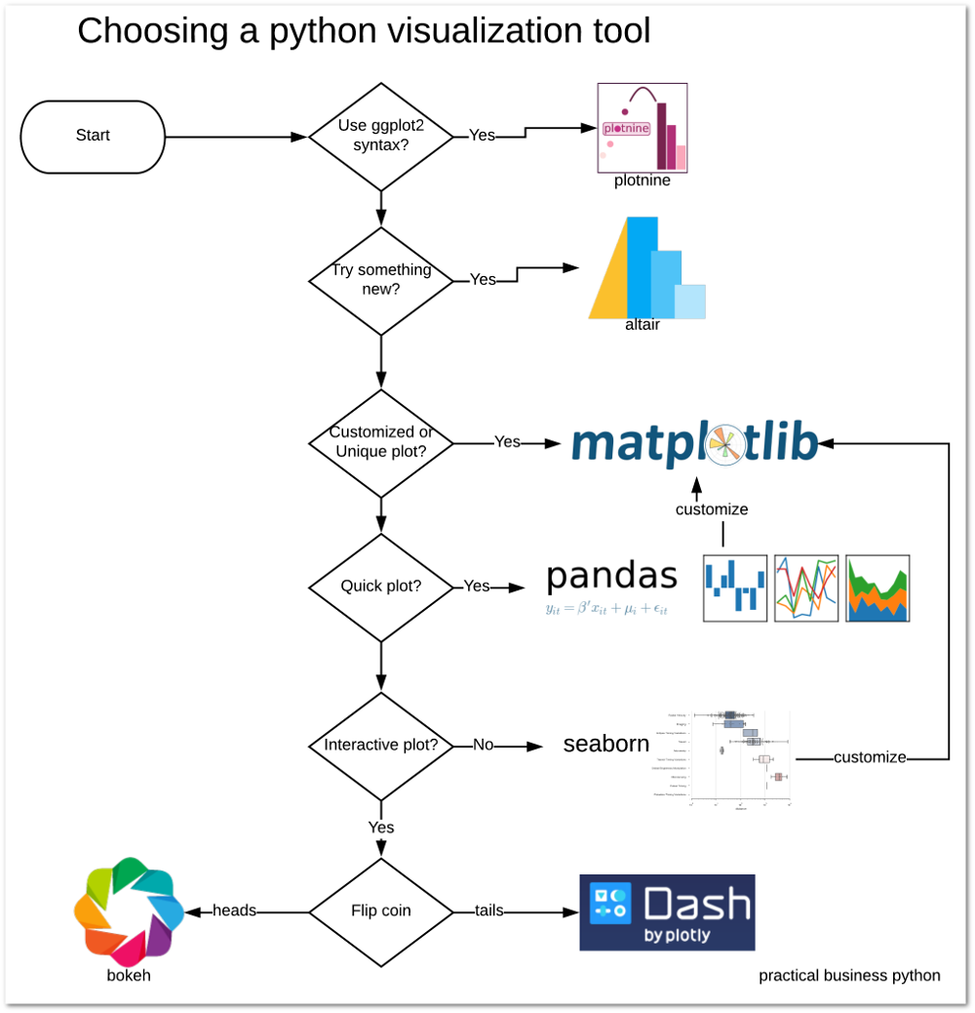
How Do you Pick One?
https://pbpython.com/python-vis-flowchart.html

Slide 5

We Chose Plotly
Works well with Pandas
Easy to use
Publication-ready
Interactive
Works with other languages
https://plotly.com/python/
https://plotly.com/r/

Slide 6



